Slide 1
Veteran Forum Sydney – August 2024

Slide 2
Veteran Forum – Sydney – August 2024
Welcome
Sonia Gregory
Deputy Commissioner NSW/ACT, Department of Veterans’ Affairs

Slide 3
Veteran Forum – Sydney – August 2024
Agenda
Item | Presenter | Timings
Welcome | Sonia Gregory, Deputy Commissioner NSW/ACT, Department of Veterans’ Affairs | 3:00 – 3:05pm
Minister’s Address | Matt Keogh MP, Minister for Veterans’ Affairs and Defence Personnel | 3:05 – 3:20pm
Veterans Legislation Reform | Luke Brown/Simon Hill, Department of Veterans’ Affairs | 3:20 – 3:50pm
Q&A | Matt Keogh MP, Minister for Veterans’ Affairs and Defence Personnel | 3:50 – 4:45pm
Close and refreshments |  | 4:45 – 5:00pm

Slide 4
Veteran Forum – Sydney – August 2024
Minister’s Address
Matt Keogh MP
Minister for Veterans’ Affairs and Defence Personnel

Slide 5
Veteran Forum – Sydney – August 2024
Veterans’ Legislation Reform
Luke Brown and Simon Hill
Department of Veterans’ Affairs

Slide 6
Veterans’ Entitlements, Treatment and Support (Simplification and Harmonisation) Bill 2024 Creating a simpler, easier to use system for the veteran community

Slide 7
Core Elements of the Bill
If passed, the Bill will implement the proposed single Act model, shaped by feedback received from the veteran community.
The core elements are:
all new claims for compensation and rehabilitation will be considered under an improved MRCA from 1 July 2026
closing the VEA and DRCA to most new compensation related claims
VEA and DRCA compensation payments being received at the commencement date would be grandparented, protecting existing entitlements.

Slide 8
MRCA Improvements
Compensation for severely injured veterans over pension age, and their dependants
Universal entitlements when travelling by car to get treatment
Extended coverage for liability
medical event while on duty
service-related smoking (up to 31 December 1997)
Accepting claims on a presumptive basis for certain conditions
Improvements to permanent impairment (PI) payments
date of effect
posthumous lump sum conversion
Notes:
A full list of changes is available at www.dva.gov.au/legislationreform

Slide 9
MRCA Improvements (cont’d)
More beneficial Statement of Principles (SoP) to apply in review/appeal
Greater flexibility for directing payments primary carer of young dependants
Protection for persons in vulnerable circumstances
mandatory financial and legal advice before receiving payment
Notes:
A full list of changes is available at www.dva.gov.au/legislationreform

Slide 10
For current VEA Veterans and Families
VEA pensions at commencement date will continue and be indexed
No change to auto-grants of war widow/er’s pension
Additional compensation payable for a service-related death
Increased funeral compensation
Consistent final date of payment when a veteran dies
Access to earnings-based incapacity payments
Impairment compensation can be taken as a lump sum
Eligible for Household Services and Attendant Care Services

Slide 11
For current DRCA Veterans and Families
Automatic transition to MRCA incapacity payments
Can appeal decisions to the Veterans’ Review Board (VRB)
Access to Special Rate Disability Pension, Veteran Gold Card, and education assistance for children, in certain circumstances
MRCA transition threshold test:
new condition accepted under the MRCA, or
at least 5-point increase in the person’s overall impairment
Whole-of-person assessment will apply

Slide 12
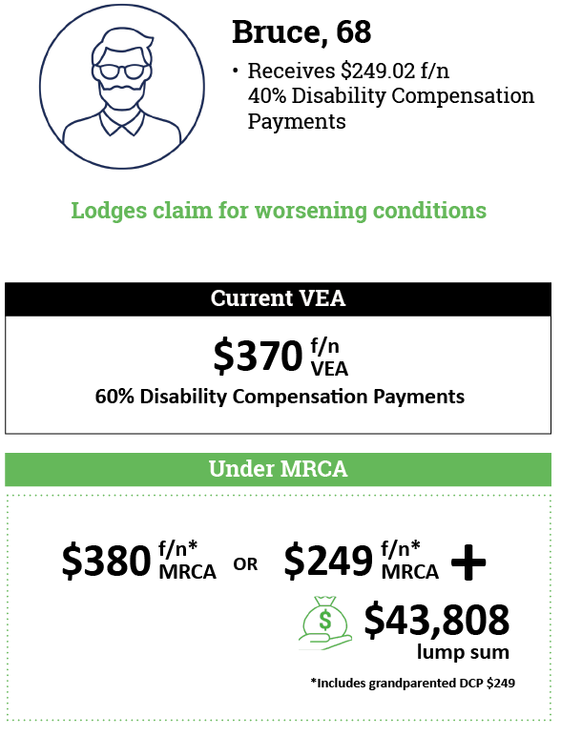
What does this Bill mean for me?
Bruce lodges a Permanent Impairment (PI) claim due to worsening conditions
Bruce undergoes a needs assessment and has his doctor complete an assessment
DVA determines Bruce’s additional impairment levels (over and above his previous impairment levels under the VEA) and and converts that into a compensation amount
Bruce can choose to receive compensation for the worsening of his conditions as an increased fortnightly payment, or convert whole or part of the additional PI amount to a lump sum (maintaining the grandparented fortnightly Disability Compensation Payment) under the VEA.

Slide 13
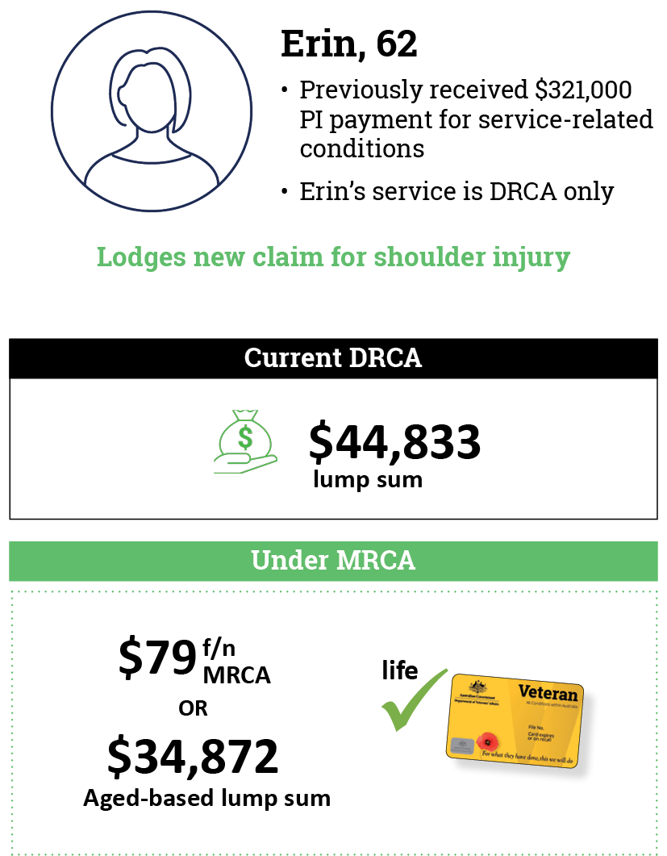
What does this Bill mean for me?
Erin lodges a claim for her shoulder injury
DVA accepts liability and conducts a needs assessment which includes a claim lodged by Erin for Permanent Impairment (PI) compensation
Erin has her doctor complete an impairment assessment for all service-related conditions
DVA determines Erin’s additional impairment levels (over and above her previous impairment levels under the DRCA) and converts that into a compensation amount
Erin is given a choice of a fortnightly payment or an aged-based lump sum (or a combination)
Erin also receives a Gold Card as her total impairment is over 60 points (for previous DRCA conditions and new shoulder injury under the MRCA)

Slide 14
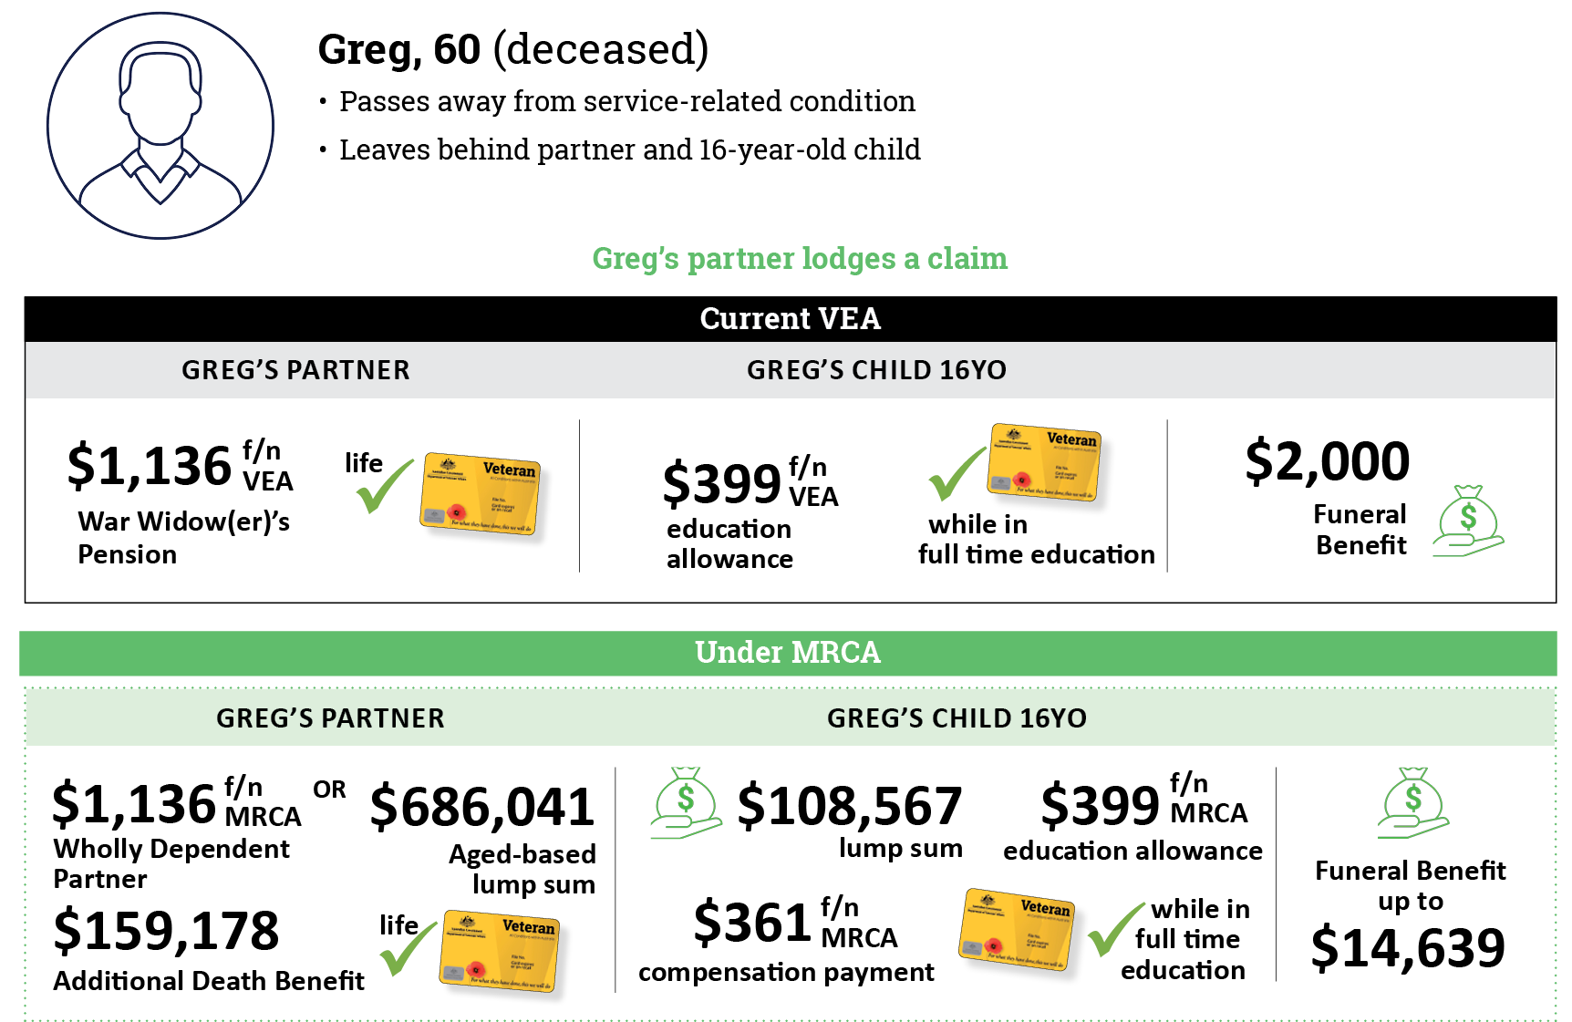
What does this Bill mean for my family?
Greg’s partner lodges a claim in respect of his death
DVA accepts liability for Greg’s death as being service-related
Greg’s partner is given a choice of a fortnightly payment or an aged-based lump sum
DVA pays additional compensation as Greg’s death is related to his service
Greg’s child receives a fortnightly payment, a lump sum and education assistance.
Greg’s family receives a higher amount of funeral compensation for a service-related death

Slide 15
Questions

Slide 16
What is available to help you understand how the Bill would operate?
Please visit DVA’s website www.dva.gov.au/legislationreform
In addition to the Bill, resources include:
information booklet
scenarios
frequently asked questions

Slide 17
Veteran Forum – Sydney – August 2024
Q&A session
Matt Keogh MP, Minister for Veterans’ Affairs and Defence Personnel

Slide 18
Veteran Forum – Sydney – August 2024
Thank you for attending the Veteran Forum
You can keep up to date with DVA information via our website – dva.gov.au, or through Facebook, Instagram, You Tube or LinkedIn – search for Australian Government Department of Veterans’ Affairs

